Slide 1



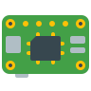

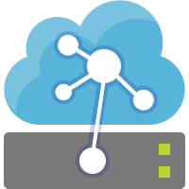
データ取得
データ収集
データ蓄積・加工
データ可視化
IoTHub
blob storage
Stream Analytics
Simulation Device
IoT Device
クエリ
SQL Database
接続文字列
input
output
Power BI
IoT Edge
IoT Edge
接続文字列
コンシューマ
グループ
Time Series Insights
streamanalytics
timeseriesinsights
イベントソース
JSON

Slide 2
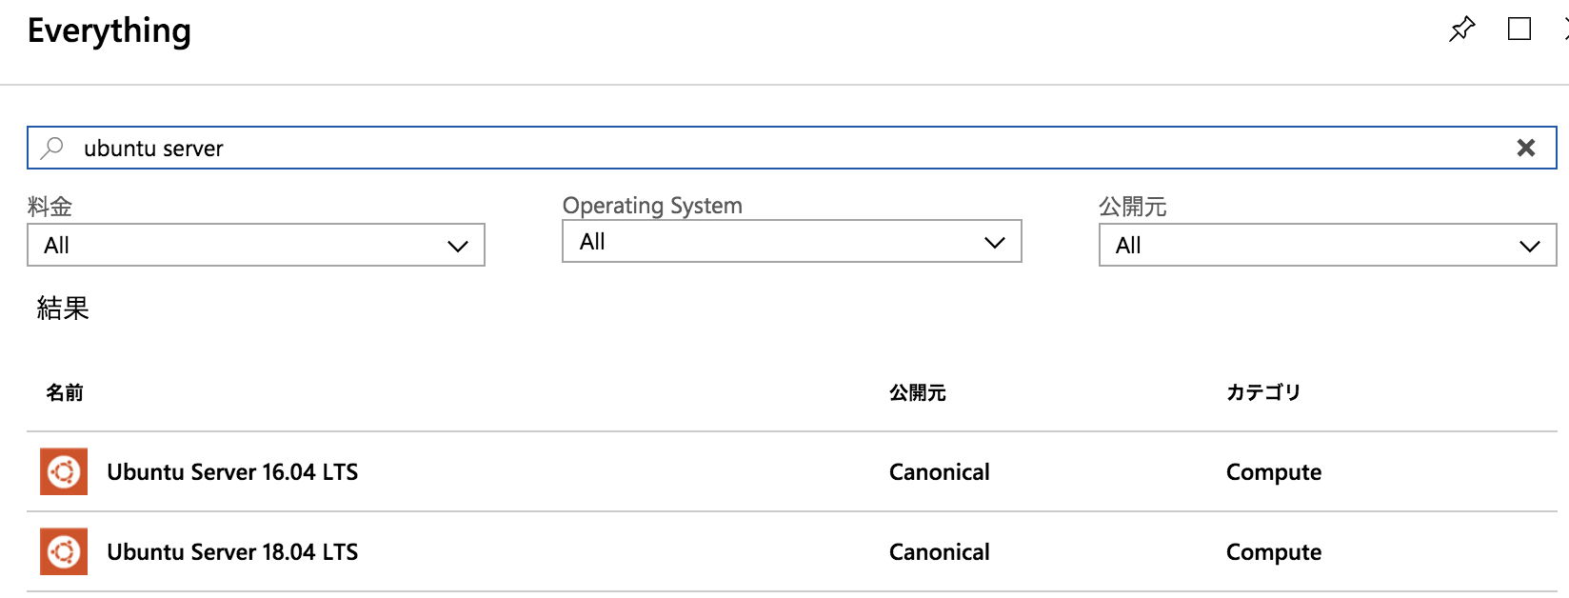
iotedge-vm-select.png

Slide 3
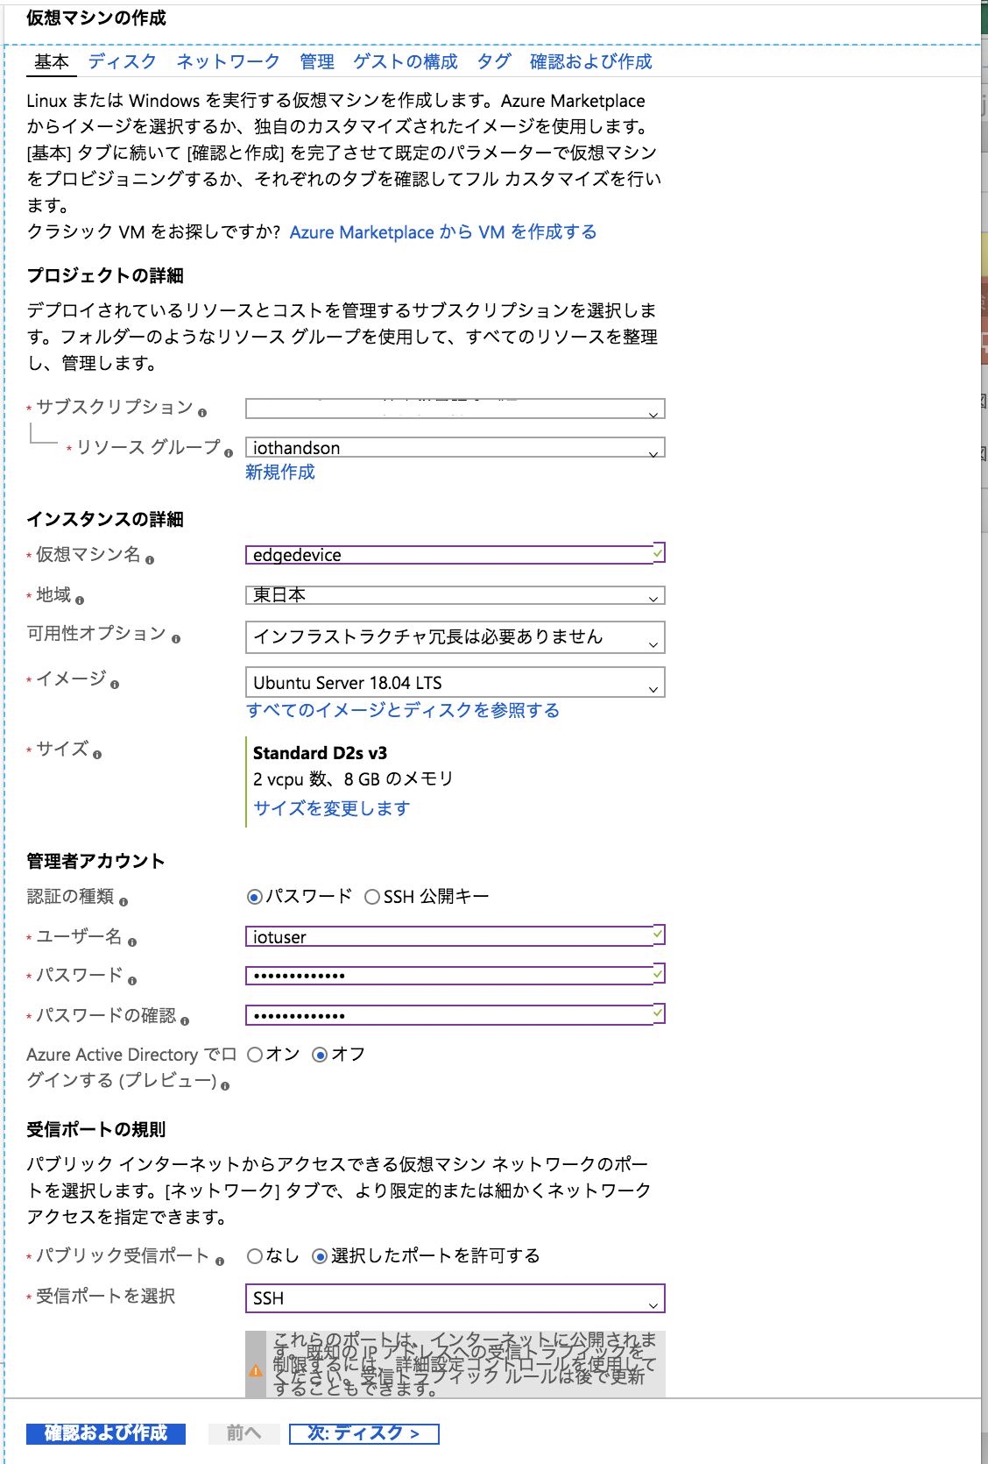
iotedge-vmconfig-basic.png

Slide 4
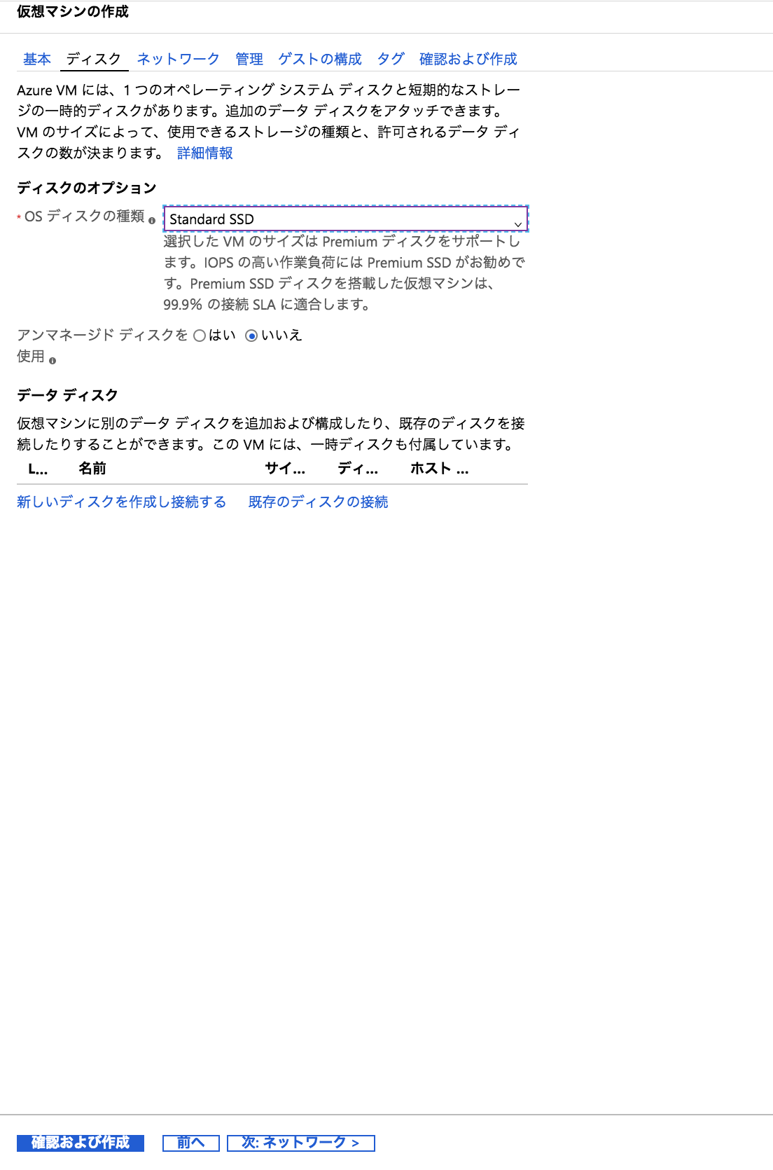
iotedge-vmconfig-disk.png

Slide 5
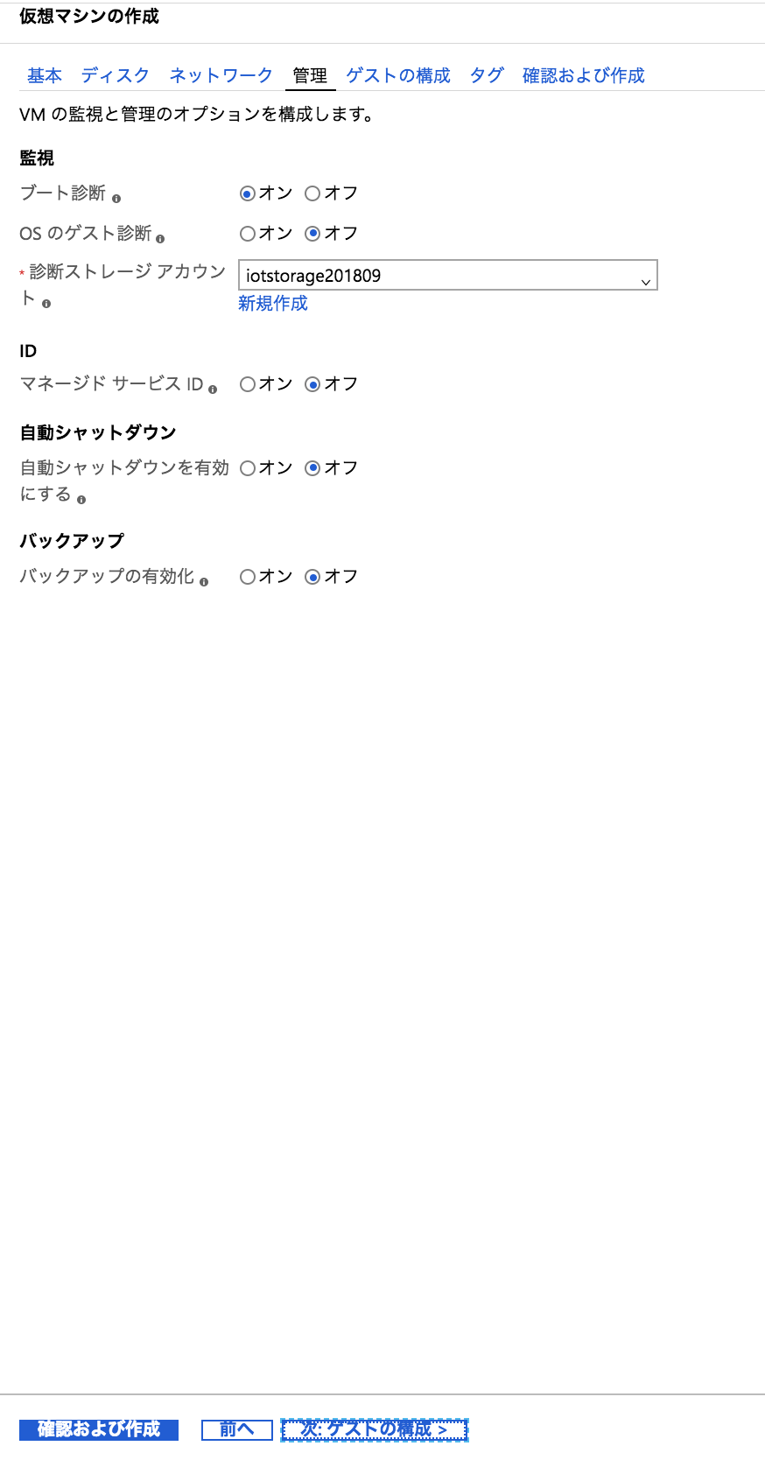
iotedge-vmconfig-manage.png

Slide 6
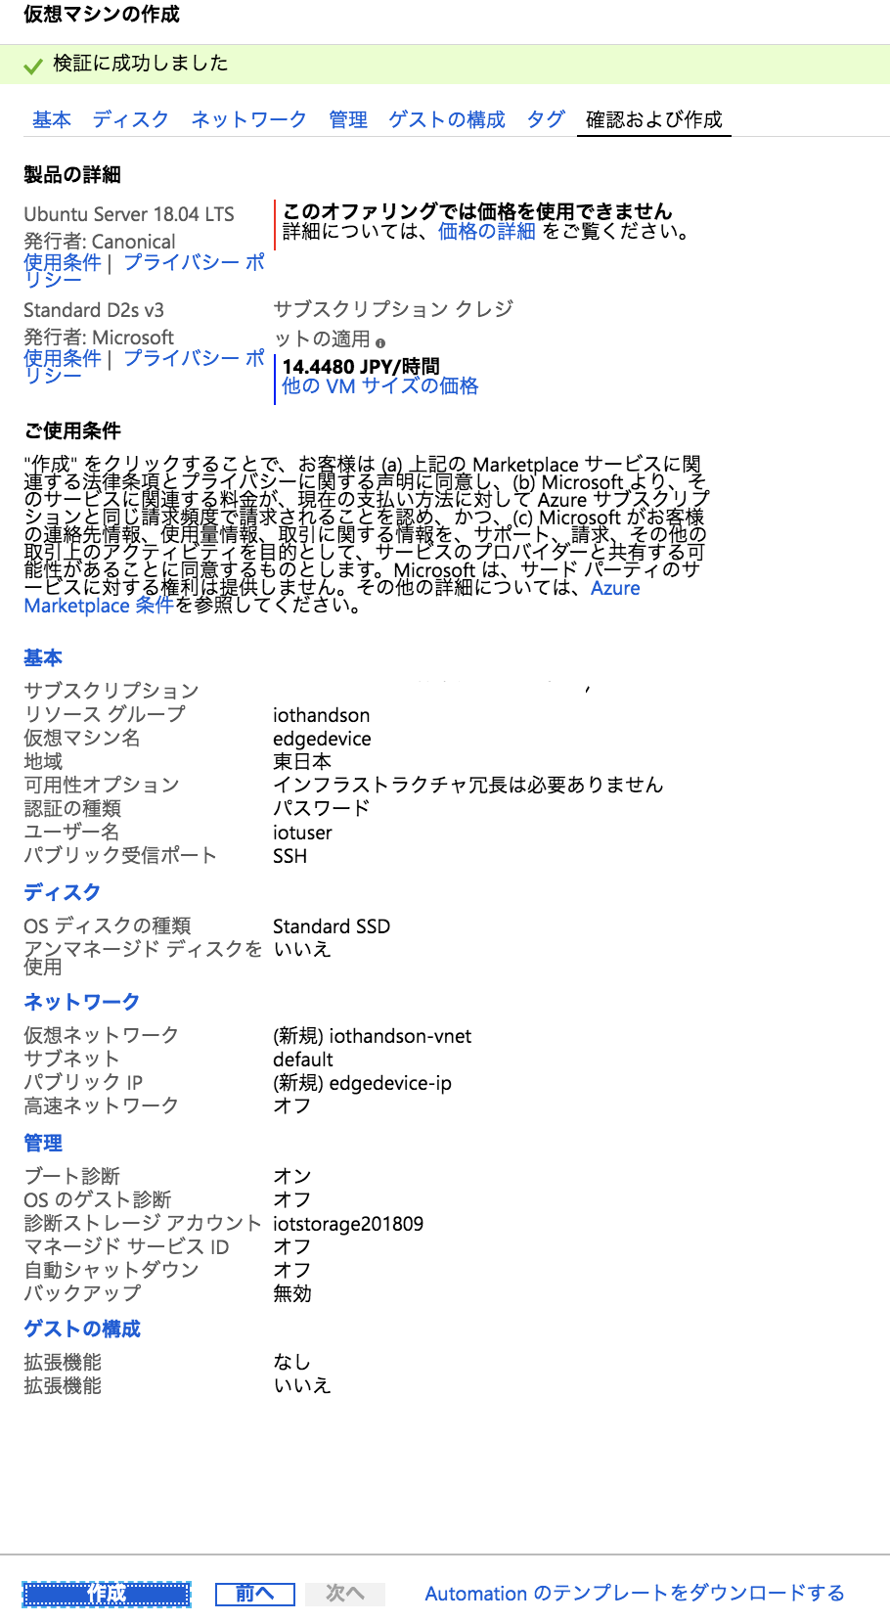
iotedge-vmconfig-overview.png

Slide 7
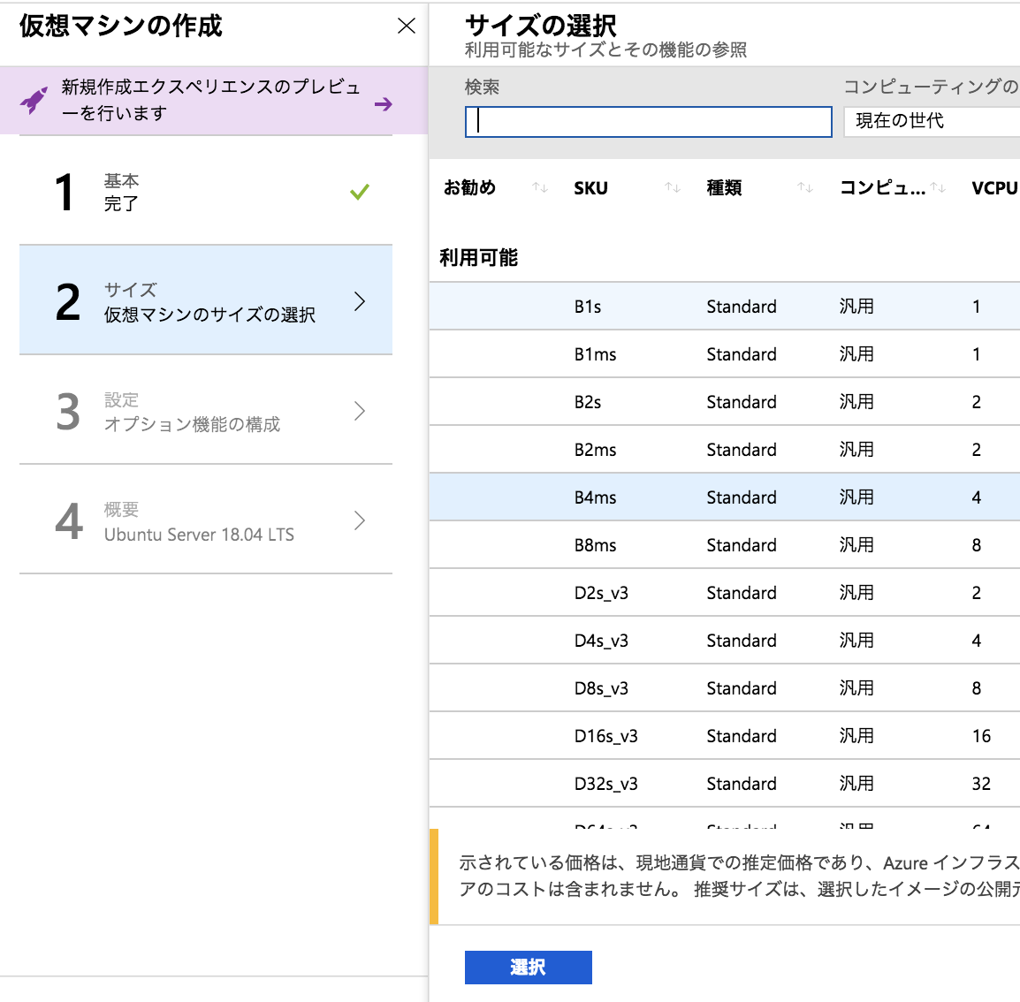
iotedge-vmconfig-size.png

Slide 8
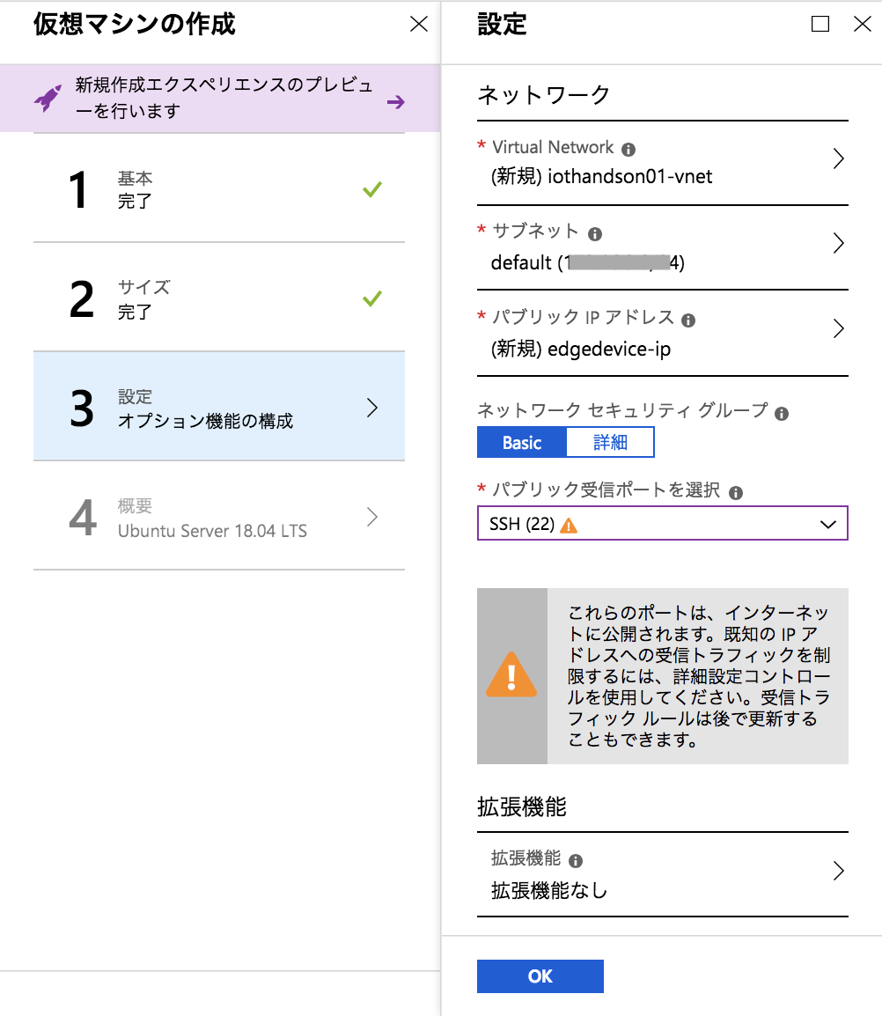
iotedge-vmconfig-config.png

Slide 9
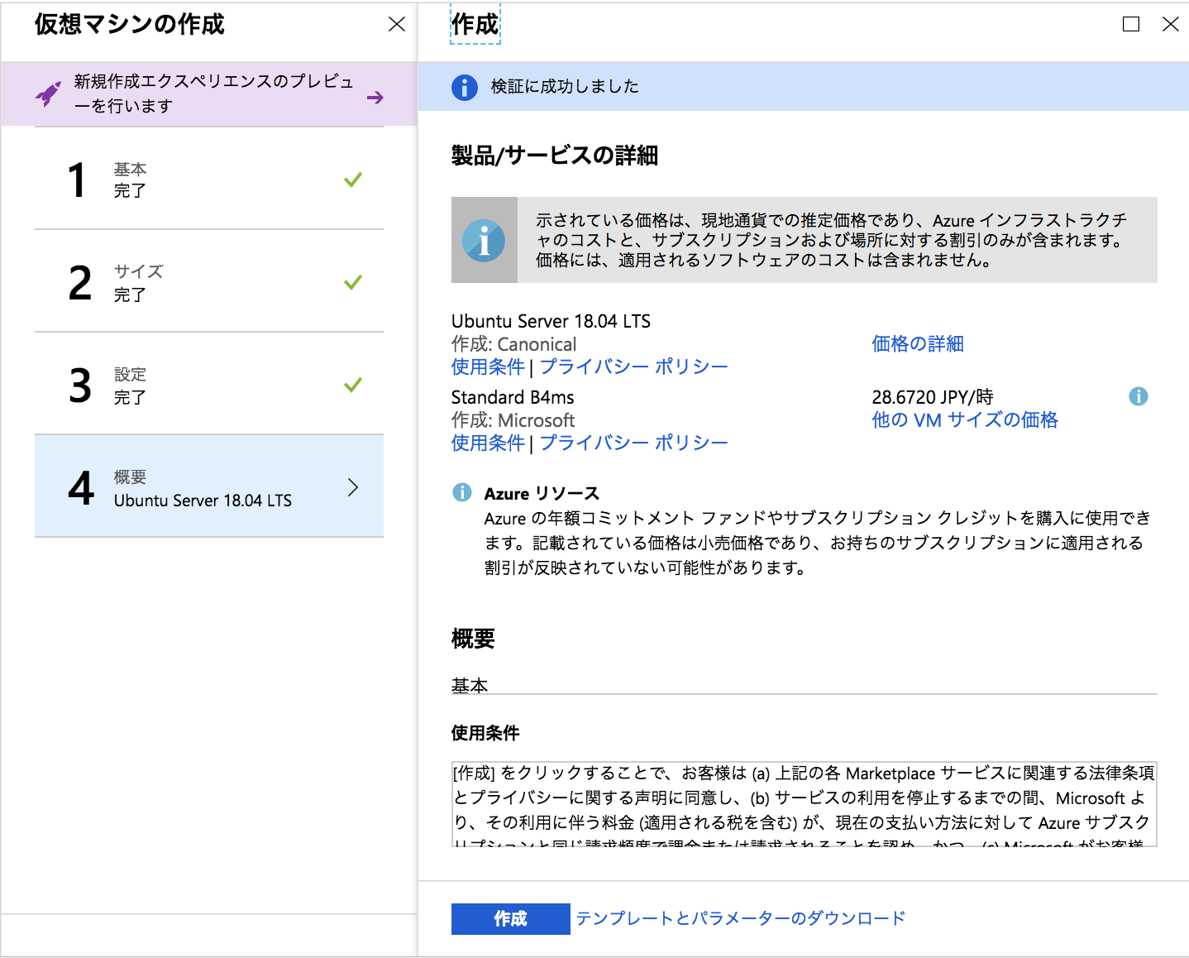
iotedge-vmconfig-overview.png

Slide 10
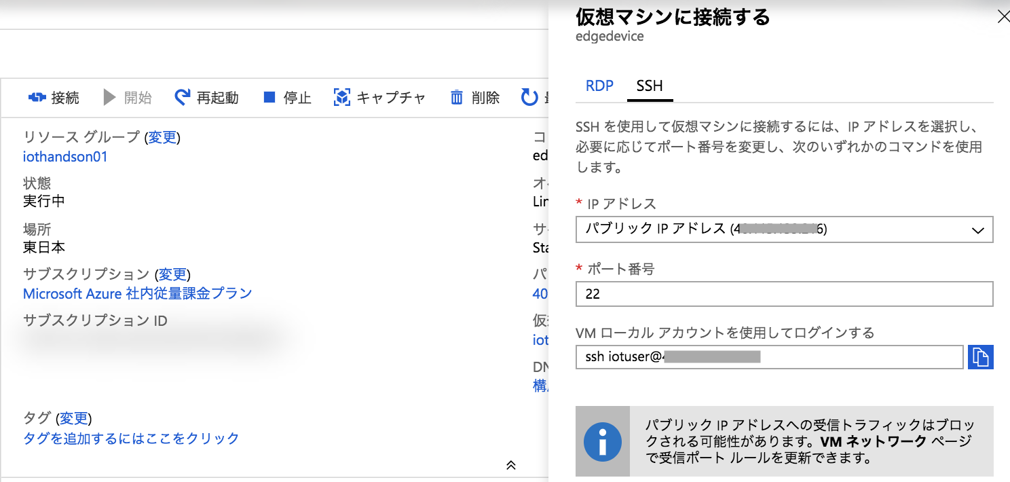
iotedge-vm-sshstring.png

Slide 11
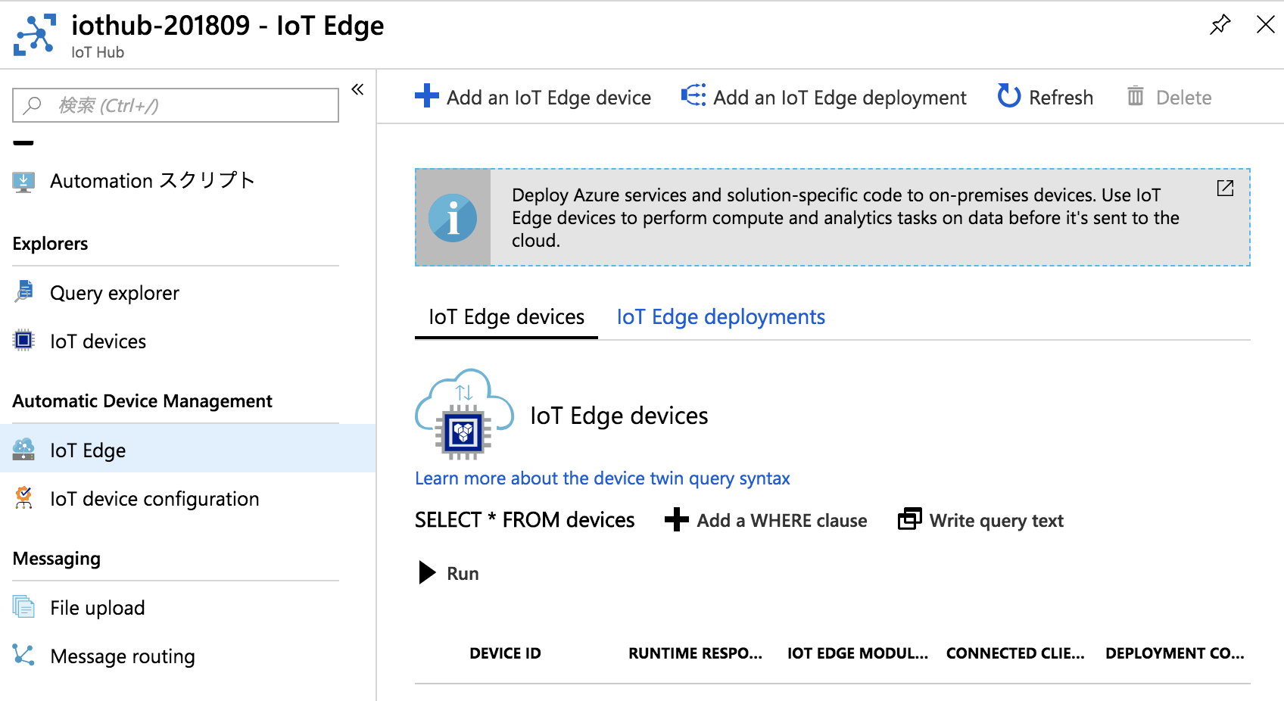
iotedge-device-add.png

Slide 12
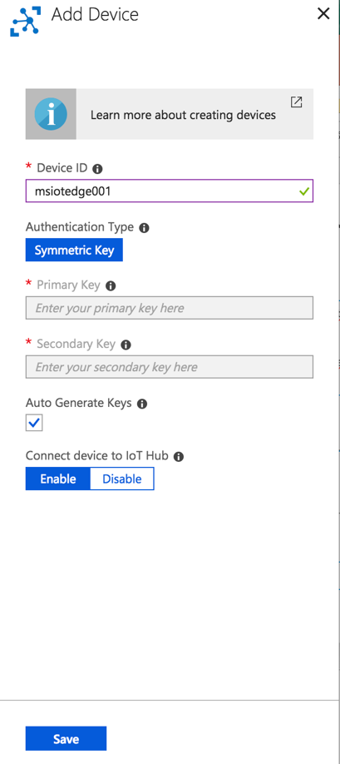
iotedge-device-save.png

Slide 13
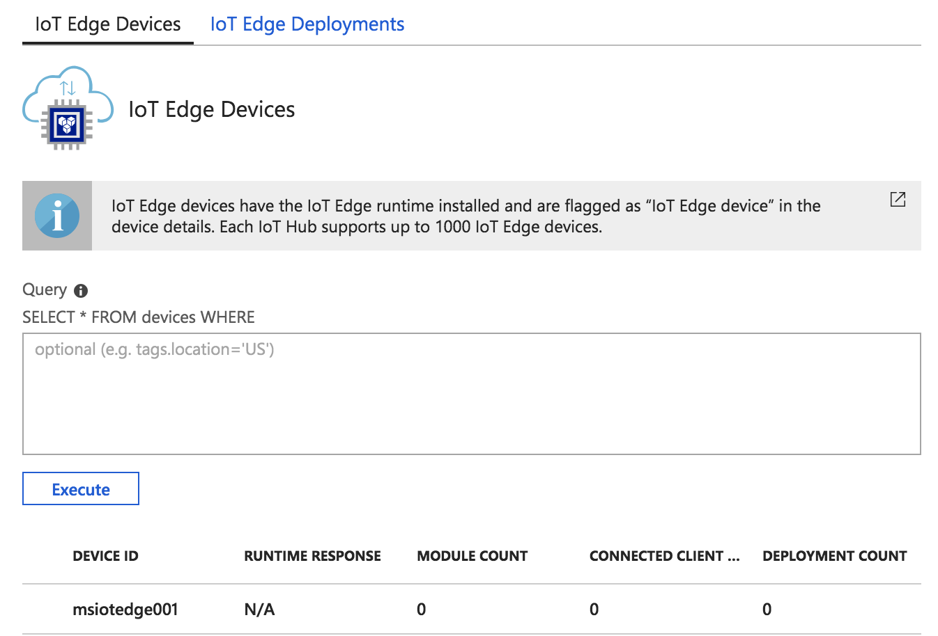
iotedge-device-list.png

Slide 14
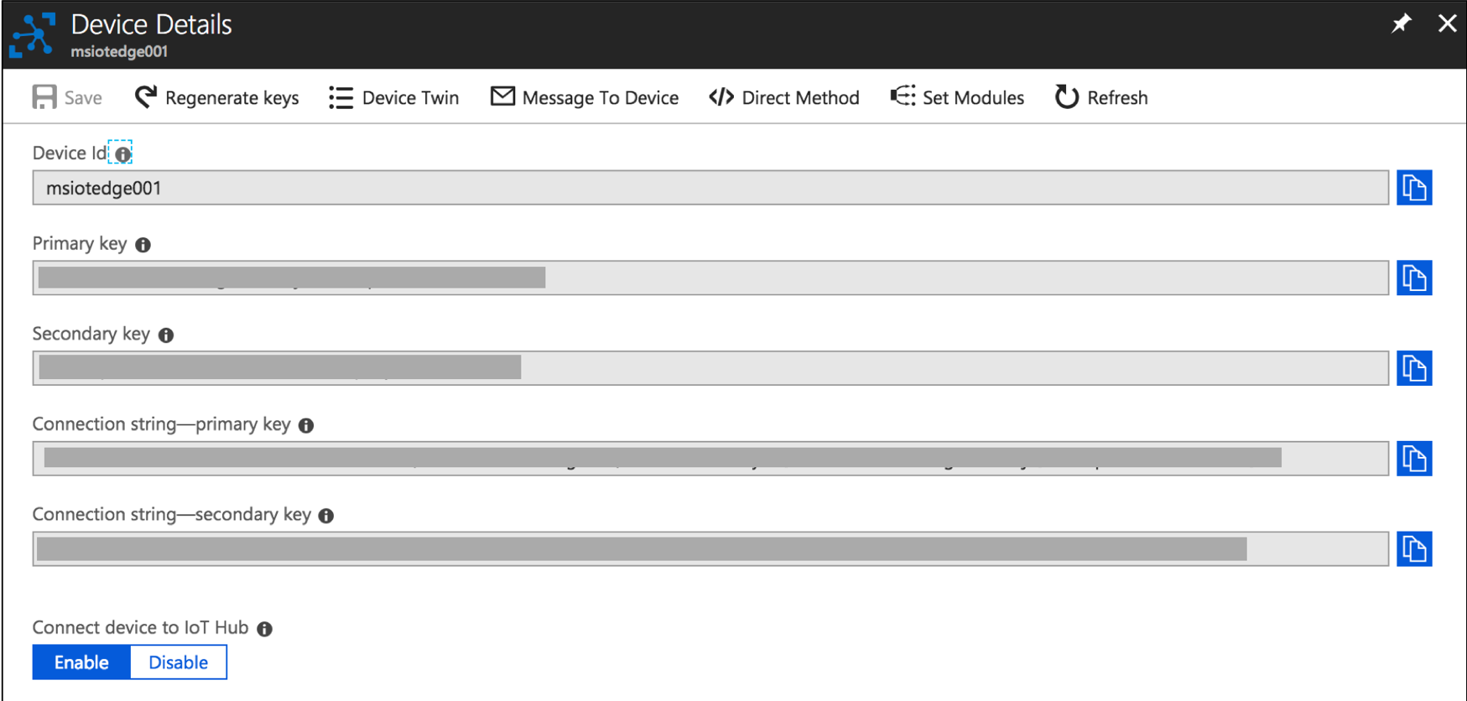
iotedge-device-copy-connectionstring.png

Slide 15
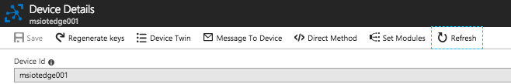
iotedge-device-refresh.png

Slide 16
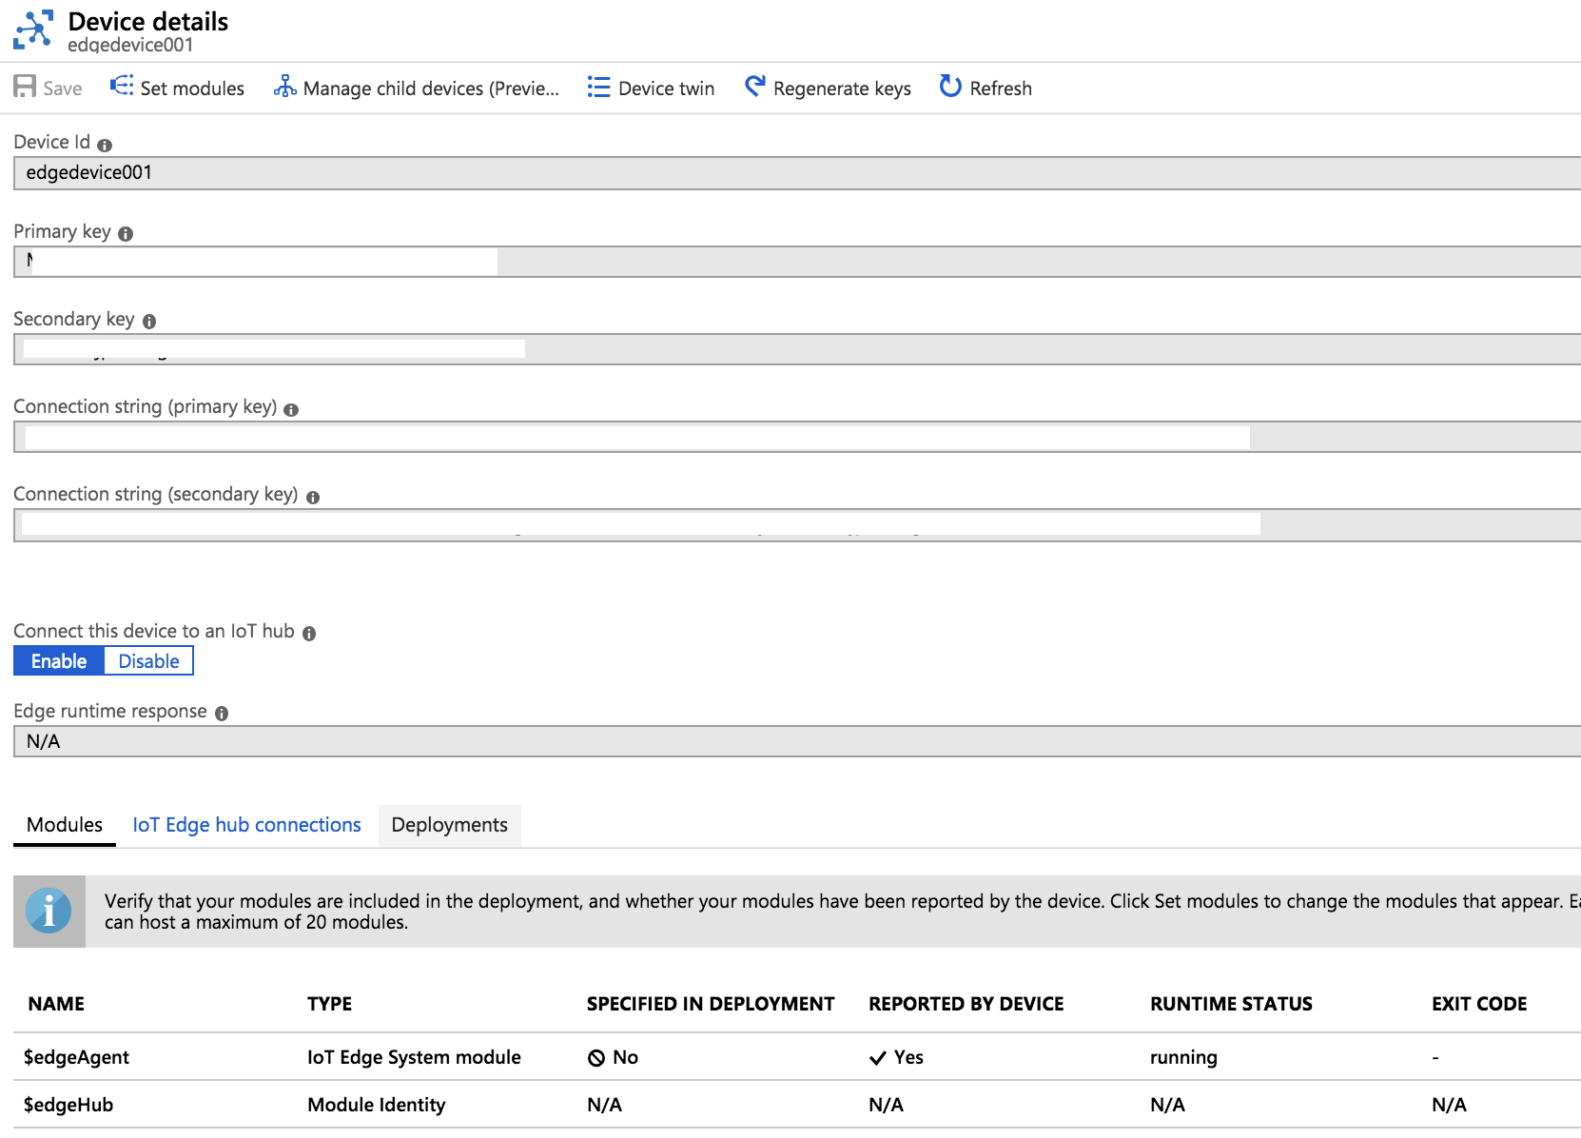
iotedge-device-list-edgeagent.png

Slide 17
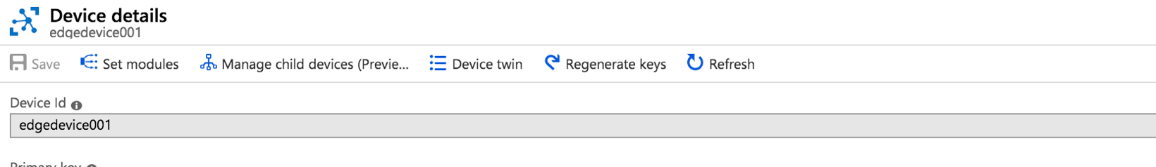
iotedge-simdevice-setmodule.png

Slide 18
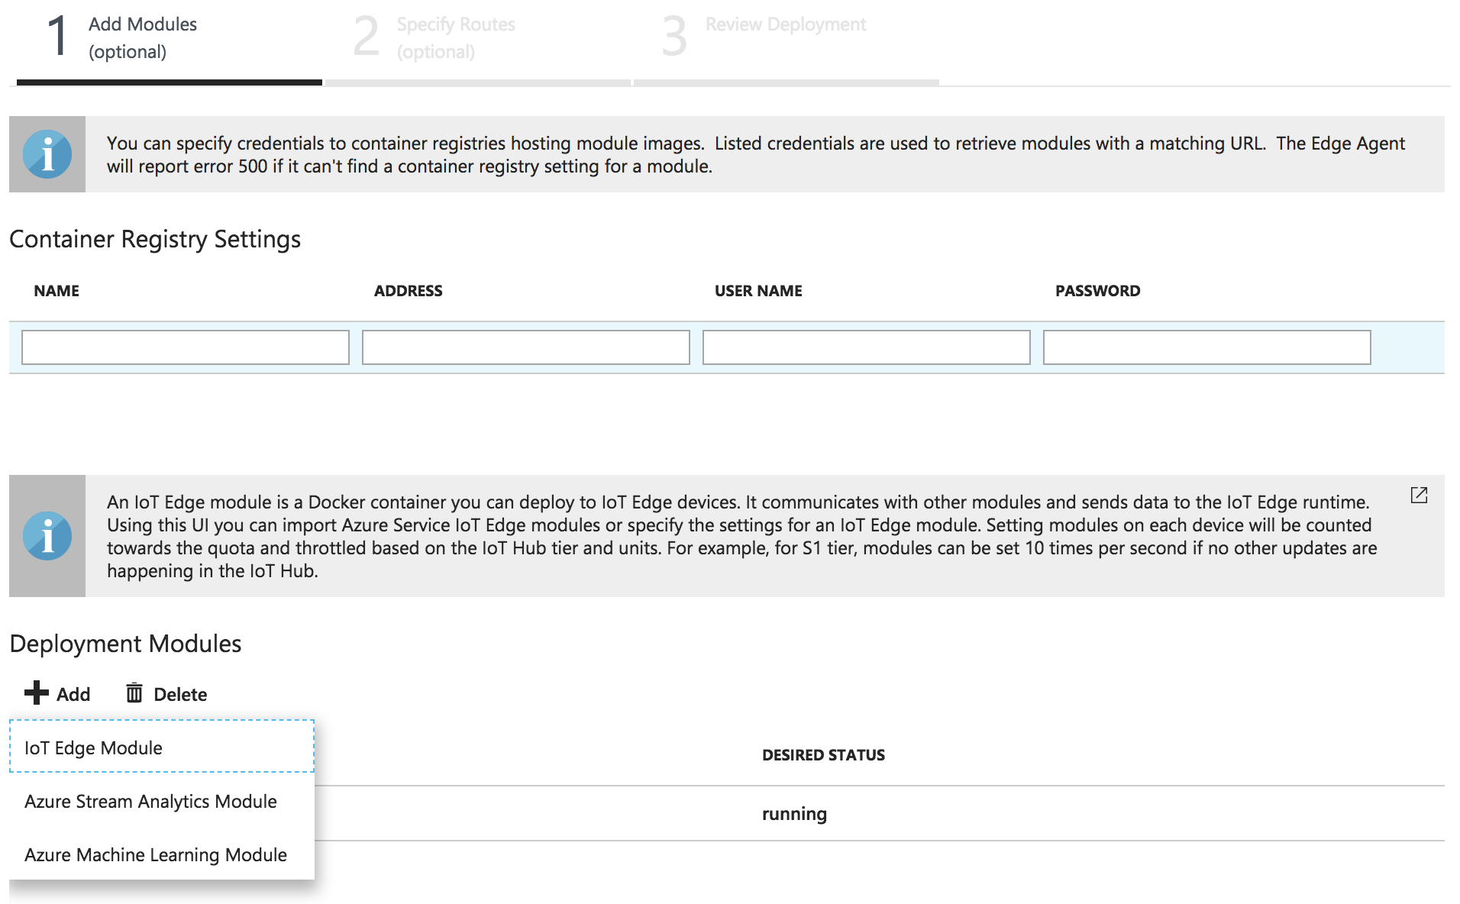
iotedge-simdevice-addmodule.png

Slide 19
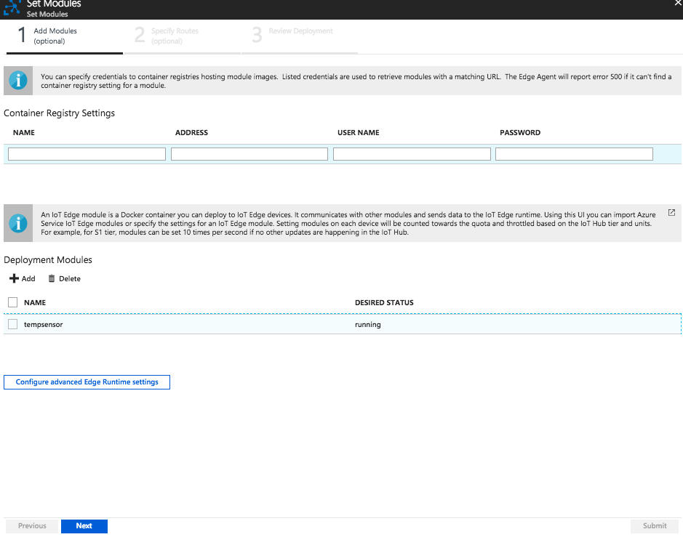
iotedge-simdevice-next.png

Slide 20
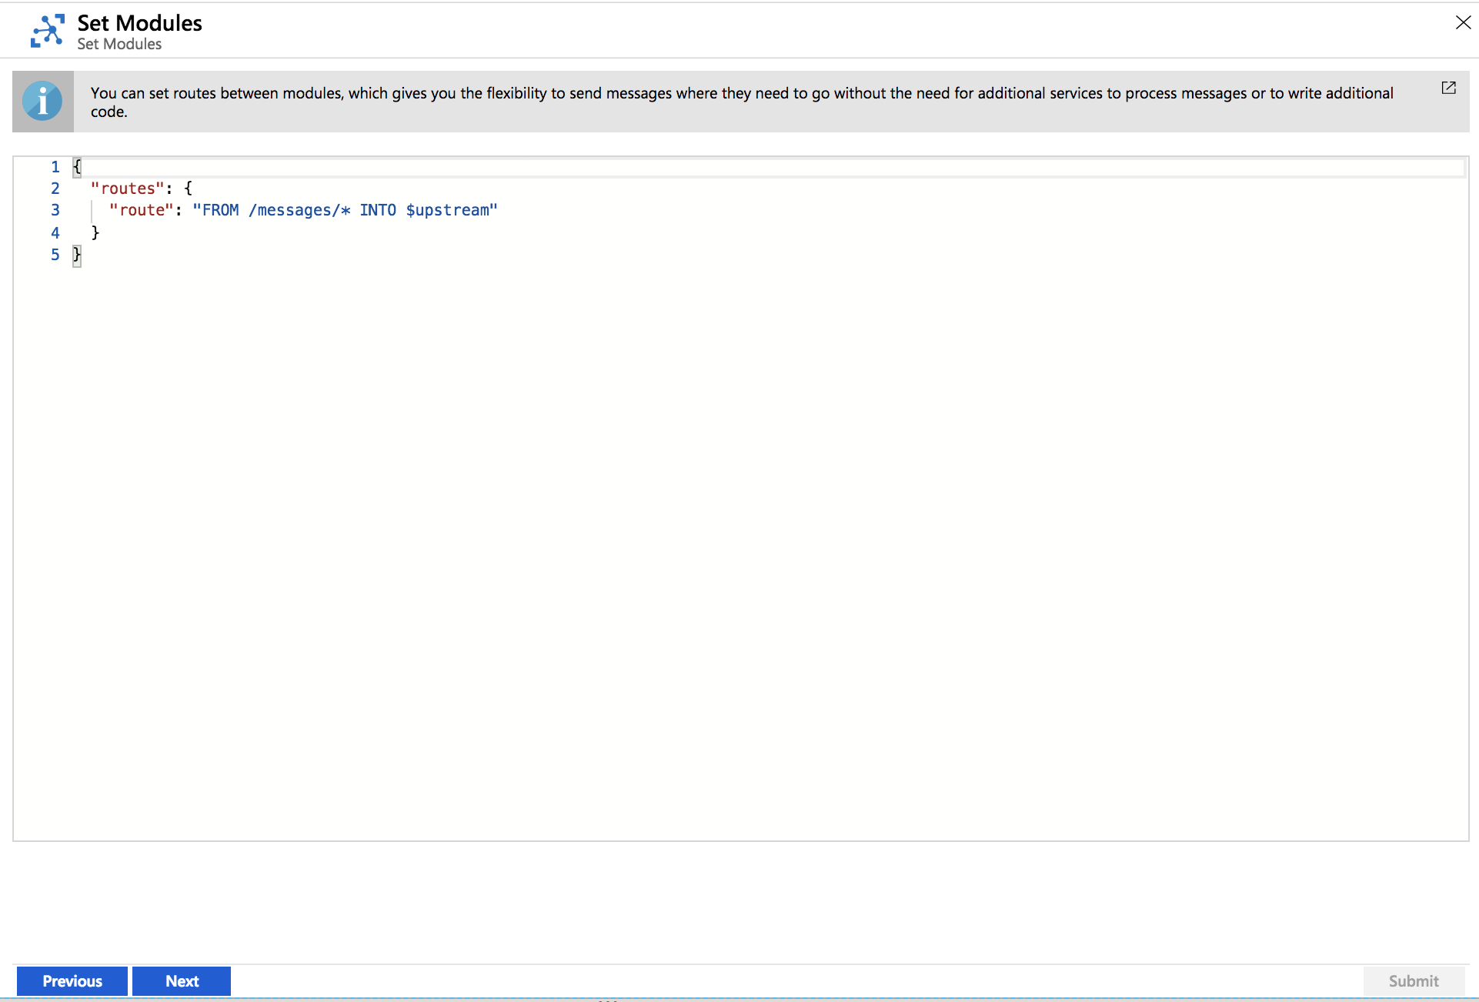
iotedge-simdevice-routing.png

Slide 21
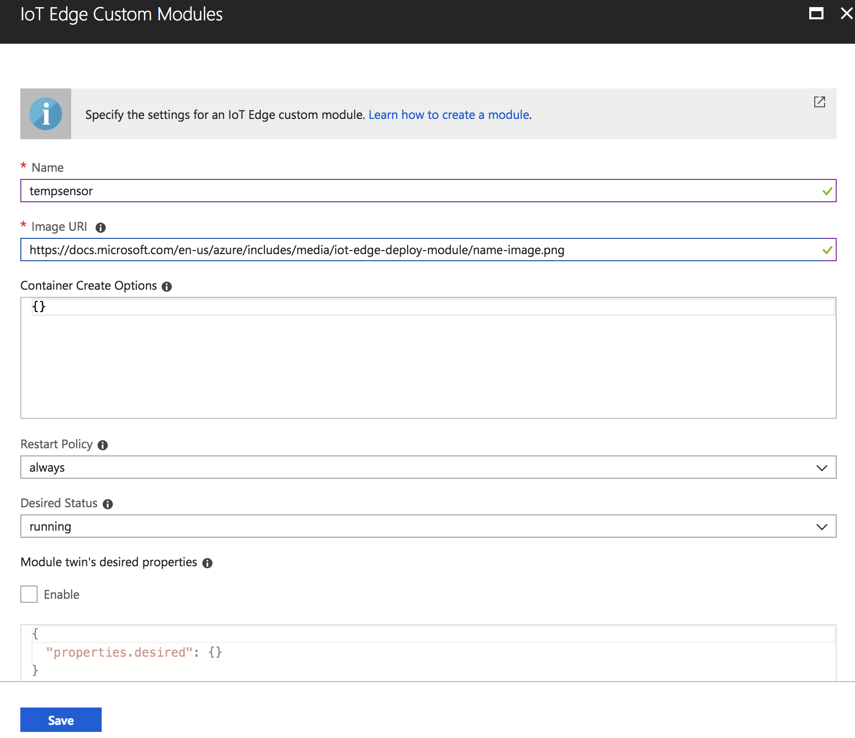

Slide 22
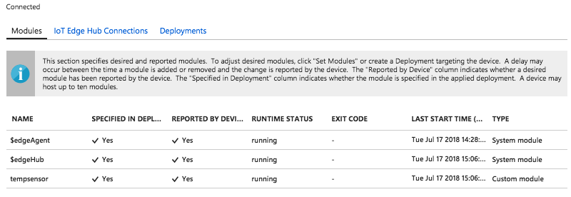
iotedge-simdevice-status.png

Slide 23
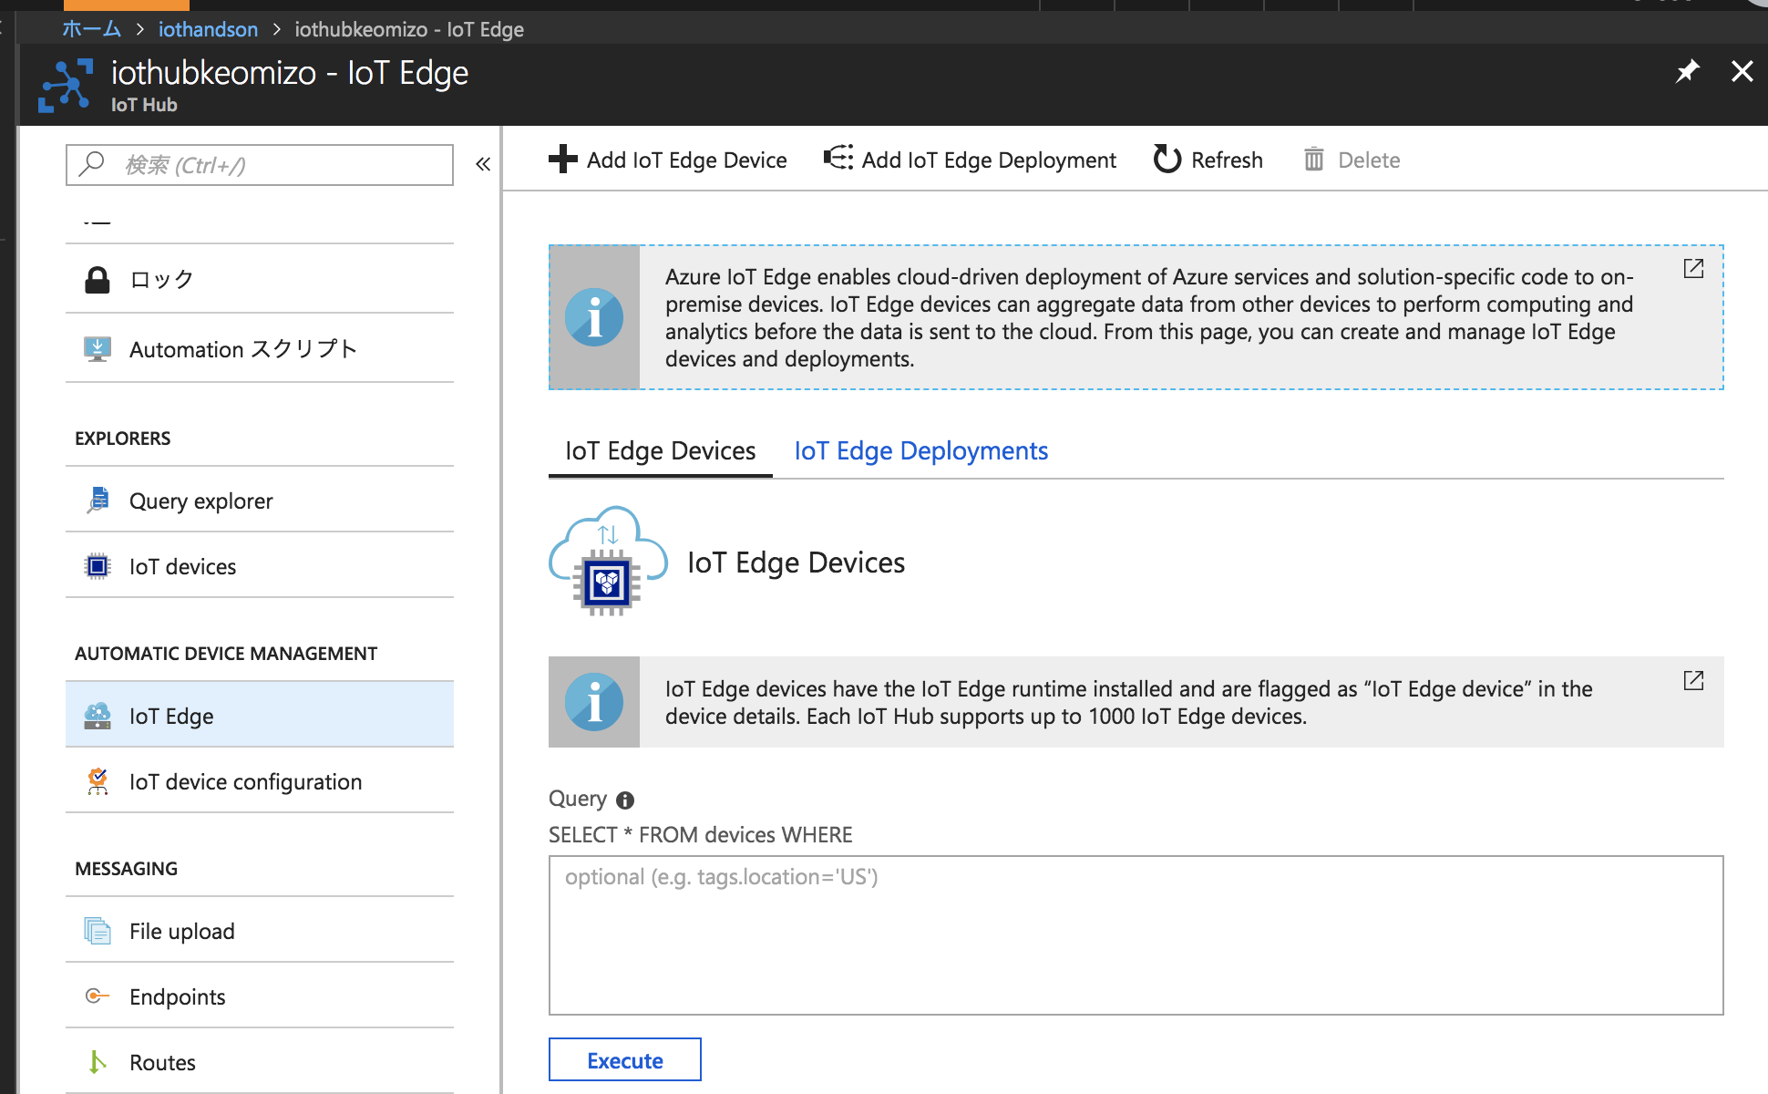

Slide 24
